Slide 1
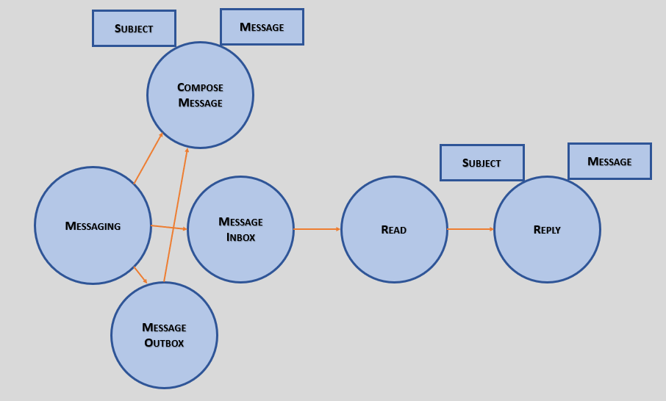
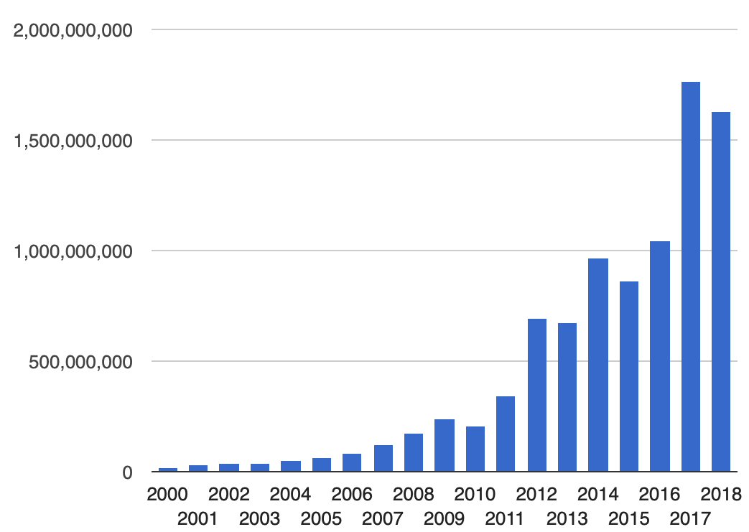
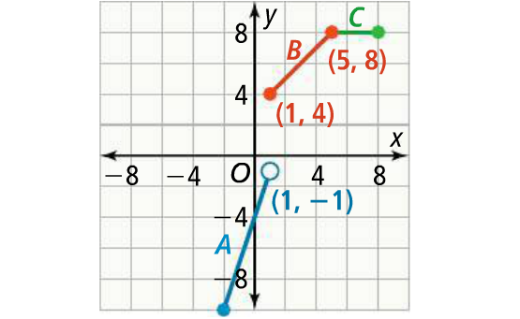
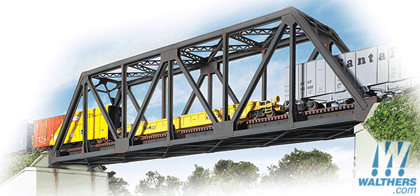
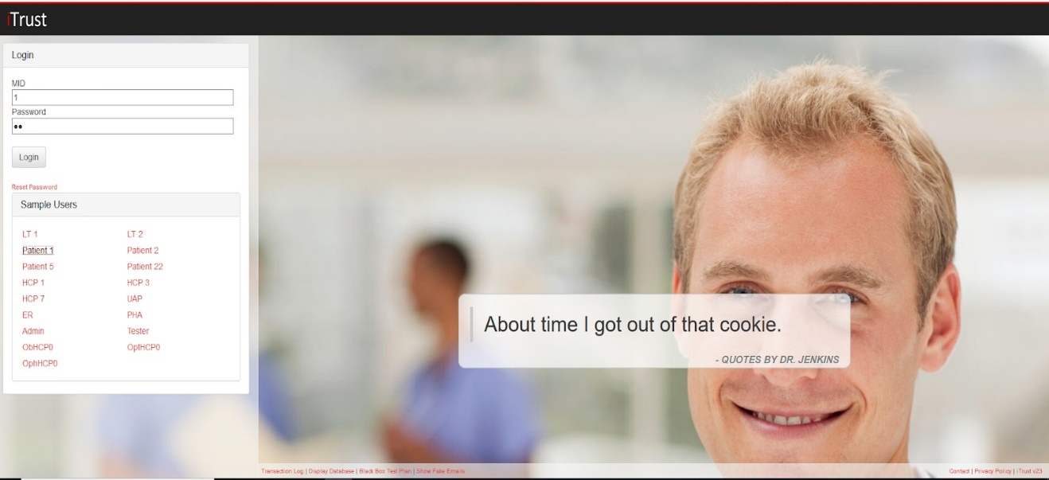
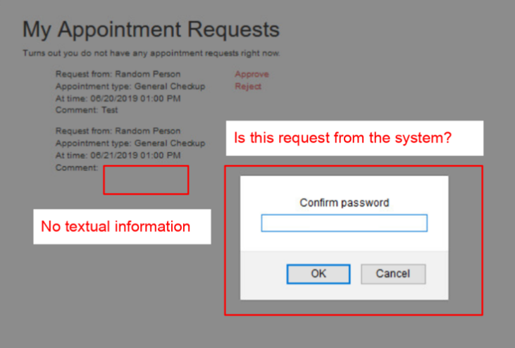
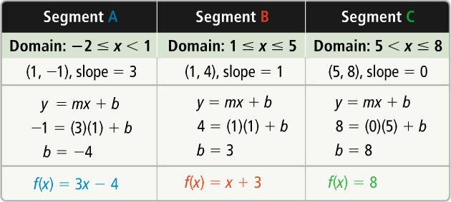
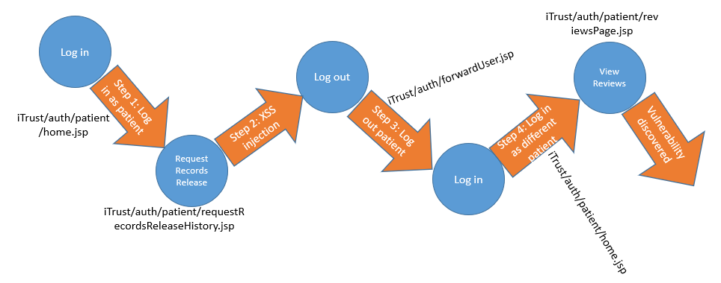
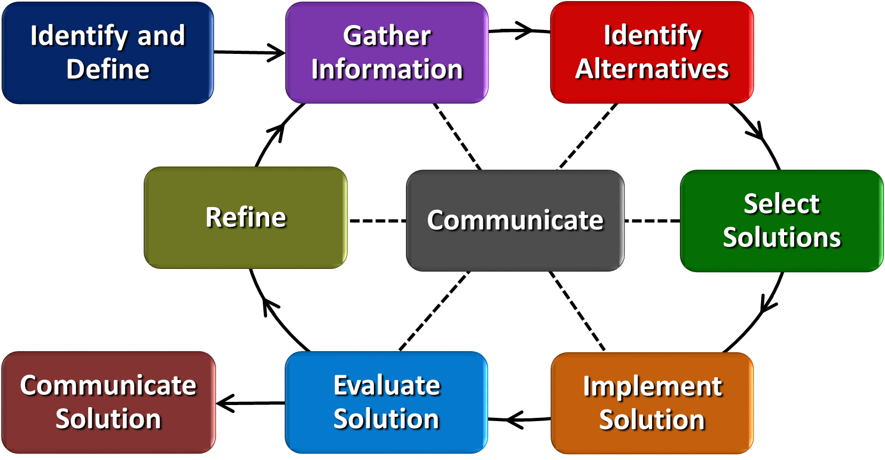
Secure Software Development Elsheika Thompson Beechwood High School, Algebra 1
RET is funded by the National Science Foundation, grant # EEC-1710826
Research
Classroom Connections
Classroom Implementation
Goal: Design an automated tool to detect web application vulnerabilities.
Big Idea: Algebra is everywhere and can be used to interpret information and make informed decisions.
Total number of websites; website means unique hostname (a name which can be resolved, using a name server, into an IP address)
Prior knowledge:
Write equations of linear functions
Graph linear functions
Identify domain and range of a linear function
Write and graph linear piecewise-defined functions.
Our team discovered vulnerabilities along several pathways on the iTrust web application.
SiteLock maintains that 4.44% of websites have at least one cross-site scripting (XSS) vulnerability. Meaning that there are more than 7.2M vulnerable sites.
Security is key when building software or physical structures. Bridge design utilizes linear piecewise-defined functions to ensure security.
iTrust web application used to inject XSS vector bugs.
Pop-up box - Indication of successful XSS vector injection.
Students will learn:
To collaborate with others to create a product
To apply Algebra concepts to our every day living
That a problem can have multiple solutions and/or multiple routes to a solution.
Algorithm for pathway taken on iTrust web application where vulnerability was detected – when coding automated tool this is crucial.
The Engineering Design Process can be used as students design, build, test, and refine a model truss bridge.

